Slide 1
2025 TLS Intern Project Kickoff
RMS Intern Program
Presented by: Daejah Walker, Sara Gonzalez Henao
Intern Program TLS Project Leads

Slide 2
Agenda
Introductions
Roles and Responsibilities
RMS Intern Project Overview
TLS Project Overview
TLS Project Execution
TLS Project Deliverables
TLS Project Timeline
SOW Review
Expectations
Engagement
Charging Guidance
Open Floor

Slide 3

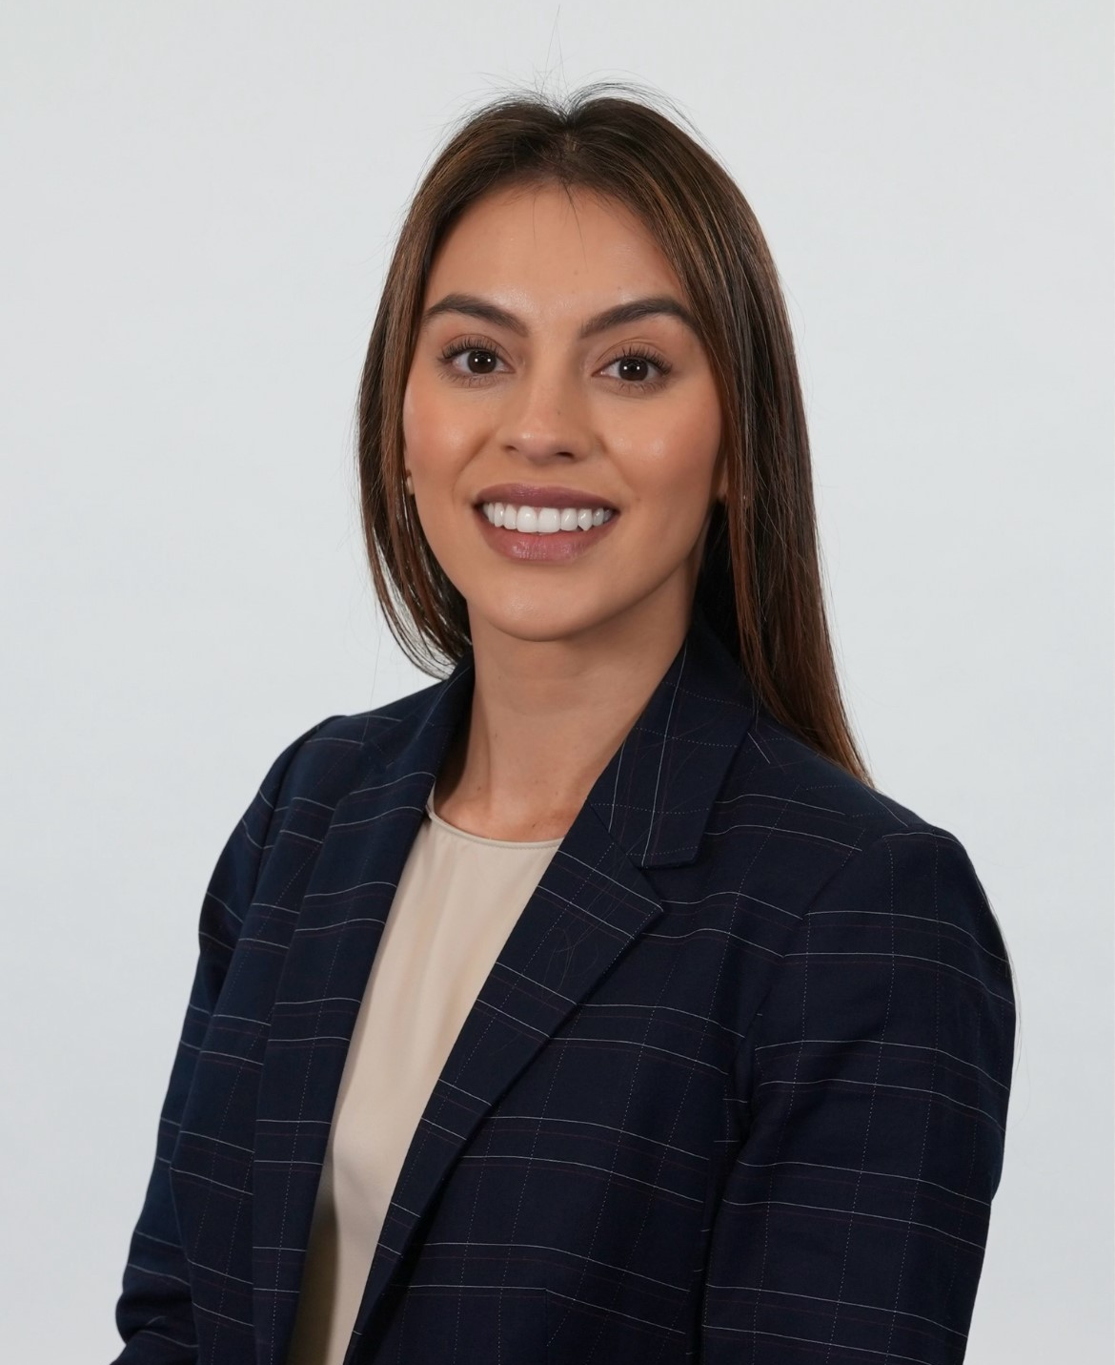

Introductions - Leads
Daejah Walker
TLS Lead
LM RMS Orlando Intern 2019, 2020
ELDP – Deputy EPM for eCASS FoT
Sara Gonzalez Henao
TLS Lead
MFG Intern
ELDP - Deputy IPT Lead – F-35 PTD (ES)
Raquel Guzman
TLS Site Coordinator
ELDP - Scrum Master and Software Engineer – F-35 PTD
Notes:
All

Slide 4
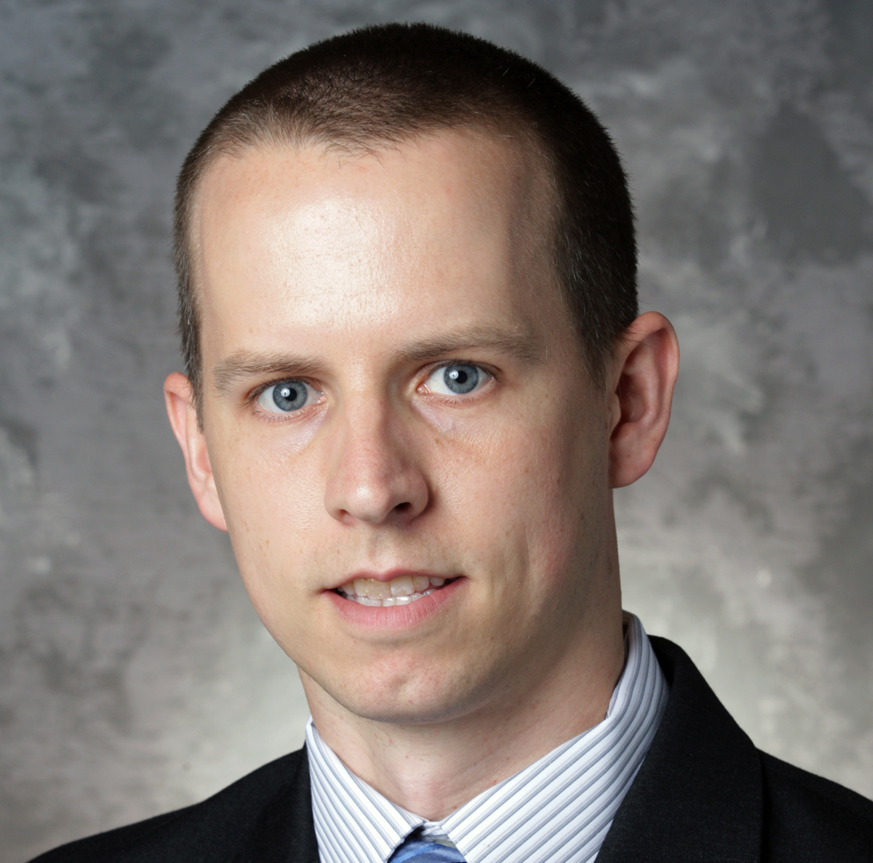
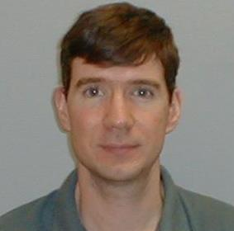
Introductions – Subject Matter Experts
Adam Moore
TLS Project SME
LM Associate Fellow
Engineering Project Manager for eCASS Family of Testers, Technical Lead for ALERT Proposal
Michael Longtin
TLS Project SME
LM Associate Fellow
Software Engineer Office of Naval Research contract called SEAMS (Simulation Enhancement and Modernization Suite), involving Electronic Warfare.
Notes:
All

Slide 5
Roles and Responsibilities
Site Coordinator | TLS Project Lead
Responsible for all site activities Technical Events Networking Events Social Events Provides support for all non-project related issues Not affiliated with Intern Project | Responsible for execution of Intern Project Answers all questions pertaining to Intern Project Plans TLS project lectures Provides guidance and instruction on project through summer Not affiliated with site-based events
Project questions should be directed to Project Leads

Slide 6
E&T Project Overview
IWSS
SAC
TLS
Hypersonic Threat Mitigation System
Multi-Use Environment Sensor
C6ISR
RMS Lines of Business
Open Architecture Data Processor
Electric Motor Test Stand
To enhance the VITA 49.2 Radio Transport (VRT) Applications software, there is a need to develop and implement a user-friendly open-system architecture interface that facilitates the interpretation of bulk export data.
To expand on hypersonic threat mitigation measures, there is a need to develop and integrate a system designed to disable or destroy incoming hypersonic threats with the capability to be modified for future mission expansion.
To continue to innovate custom electric and hybrid motor technologies for vertical lift platforms, there is a need to conceptualize and develop an electric motor test stand to accurately determine motor performance data.
To continually improve the latest training systems, there is a need to create a multi-use enclosure that will provide accurate humidity and temperature data with the ability to interact with varying software applications

Slide 7
Project TEMPER:
Temperature Enclosure for Multi-Purpose Environmental Recording
Adam Moore, Michael Longtin

Slide 8




2025 Intern Project – TLS Overview
PROBLEM STATEMENT: As Lockheed Martin leads a dedicated Line of Business (LOB) for training and sustainment, TLS seeks to continually improve the training system hardware and software to adapt to the ever-changing environment. The Internal Research and Development (IRAD) Container Team, Business Development (BD) identifies the need to design a multi-use enclosure that will provide accurate humidity and temperature data. The sensor will need to interact with two different LM software applications (STORM / COLT) to display information. Additionally, the system should log temperature and humidity data while conforming to designated customer specifications.
SUBJECT MATTER EXPERT:
Adam Moore – Engineering Project Manager / Associate Fellow
Mike Longtin – Software Engineer / Associate Fellow
SCOPE: Project execution from kickoff June 10th, 2025, to project demonstration July 28th, 2025.
Requirement Review – Analyzing required specs and MIL standards
Trade Study – Down-select temperature and humidity sensors
Integration – Interface between the software baselines
Hardware Design – Develop hardware casing, circuitry, placement for optimal use within IRAD systems

Slide 9
TLS 2025 SOW Recap
Project TEMPER
Deliverables:
Trade Study Analysis for Down Select of thermocouple
Requirements Verification Plan
API for Integration with STORM Lite
Web-Page GUI
Functional Product with Sensor
HW Model of sensor using Creo, or other related modeling software
Final PowerPoint Presentation with organization chart of assigned roles
Scope / Background: (Simplified)
Teams are expected to assess requirements and DoD Standards for identifying solution for MIL-PRF-28800 CLASS I environment and integrate a solution into the STORM Lite baseline.
Background: A new sensor must be identified. Initial research on other LM Automated Test Equipment identified non-optimal solutions (LM-CORE, eCASS, COLT – Too large/complex for the use case)
Assumptions/Constraints:
Stakeholders will be available to provide input for the duration of the project.
Stakeholders will meet with teams on a periodic basis to check progress.
Teams will engage with stakeholders early and throughout the project to ensure that their needs are understood and addressed.
The project will need to be completed by 7/28/2025 at 9 AM EST.
Requirements: (Most of the Functional)
Solution must be TAA Compliant
https://gsa.federalschedules.com/resources/taa-designated-countries/
Sensor must be capable of operating in a MIL-PRF-28800 CLASS I Environment
Sensor must detect temperatures beyond limits of the MIL-PRF-28800 CLASS I Environment
Section 3.8.2. MIL-PRF-28800G
Software communication shall be via an industry standard communication interface
Hardware interface shall be that of a standard PC (may include USB, USB-C, Ethernet, Serial).

Slide 10
Sensor Selection Criteria
Criteria | Sensor A |  | Sensor B |  | Sensor C
 | Score (1-5) | Notation | Score (1-5) | Notation | Score (1-5) | Notation
Size
Weight
Power
Cost
Reliability
Supportability
Procurement Lead Time
Score
Trade study template, also in SOW
Meets high-level requirements
SWaP-C
Size
Weight Power
Cost
Reliability (Mean Time Between Failure)
Long-term supportability
Procurement lead time

Slide 11
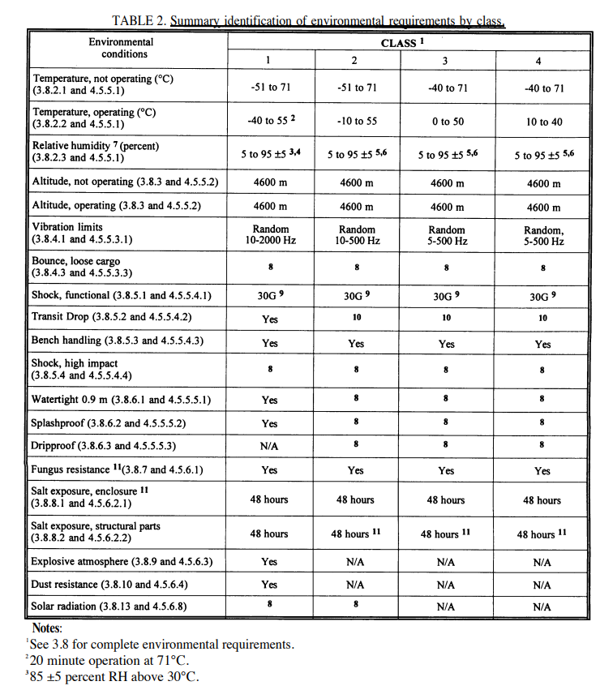

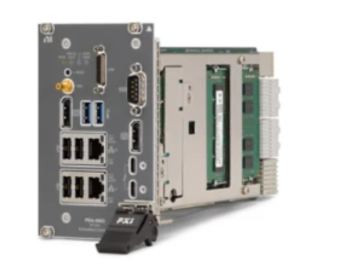
Sensor Requirements / Use Case Scenario
Sensor must be TAA Compliant – Developed in a TAA Compliant Country
https://gsa.federalschedules.com/resources/taa-designated-countries/
Sensor will be used in a MIL-PRF-28800 CLASS I Environment
Section 1.2.1a – Class 1 Definition
Section 3.8.2 – Temperature and Humidity – Sensor must exceed these boundaries
Section 3.8.2 – The sensor will be subject to these conditions within a ruggedized container.
Physical interface – Prefer a common / commercial port – USB, USB Type-C, Ethernet, Serial
Communication may route to a ruggedized laptop controller or PXIe Controller
Uses an Industry Standard communication protocol

Slide 12
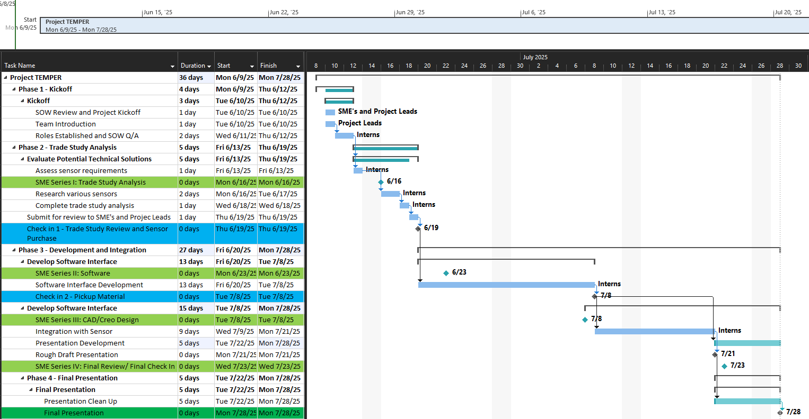
TLS Project Timeline

Slide 13
Expectations
Perform with excellence
Model personal integrity and accountability
Don’t be afraid to ask questions
Apply a growth mindset
Prioritize the Intern Program events (site and project)
Charge your time accurately
Have fun!

Slide 14
Project TEMPER:
Team Assignments and Ice Breaker
Sara Gonzalez Henao, Daejah Walker

Slide 15
Team Assignments
Team 1
Krumm, Meghan
Copelin, London
Abdelrahman, Haider
Yau, Jason
Dadla, Sophia
Glasgow, Megan
Spurlock, Jaedon
Giardina, Nicholas
Sepulveda, Yarelis
Fintel, Paige
Thomas, Erriana (remote)
Mahmoud, Alia*
Team 2
Bell, Caleb
Koch, Hunter
Heller, Dan
Badaoui-Najjar, Akram
Dominguez, Carlos
Manzie, Kamara
Nower, Jessica
Greenbaum, Chloe
Garcia, Christian
Gumudavelli, Eshaan*
Hill, Trent
Malaykhan, Crystal*
Team 3
Petro, Andrew
Klauber, Sam
Lisman, Mitchell
Burns, Connor
Rollins, Ava
Umpierre, Dylan
Shanmugam, Nahul
Finch, Luke
Mohal, Saahil
Levine, Xander
Halk, Isabella
Foster, Nathaniel*

Slide 16
Teams/SharePoint Announcement
Individuals have been added to their team's group for their team directly. Please let us know if you did not receive notification.
All documentation for your group is to be stored in sharepoint in submission folder for deliverables, which must contain related information by the expected deadline.
All information belongs to the project, so beware of what is going into the sharepoint and teams chat.

Slide 17
Communication
General questions can be asked in Teams via making a post: 2025 TLS Intern Project | US-RMS-Intern-Program | Microsoft Teams
Team specific questions, comments or concerns can be directly addressed to Sara and Daejah via email by the Project Manager.
Allow for 24 hours for a response before pinging directly.

Slide 18
TLS Charging Guidance Interns
Project Event | Dates | Charge Number | Maximum
Project Kickoff | June 10th | MT-ITR | 1 hr.
Project Lectures (SME Series) | See next slide | MT-ITR | 4 hr.
Project Check-Ins | See next slide | AD-ITP | 1 hr. (0.5 hr. per check in)
Project Working Time | June 10th – July 27th | AD-ITP | 16 hr. (CANNOT EXCEED)
Final Project Demonstration | July 28th | AD-ITP | 3 hr.

Slide 19
Project Events Details
Project Lectures (SME Series)
Date | Event
June 12th | SOW Q/A with LOB Leads (0.5 hours)
June 16th | SME Series I: Trade Study Analysis (1 hour)
June 23rd | SME Series II: Software Development (1 hour)
July 8th | SME Series III: CAD/Creo Design (1 hour)
July 23rd | SME Series IV: Final Q/A (0.5 hours)
Project Check-Ins
Date | Event
June 19th | Check In I: Trade Study Analysis Review (0.5 hours)
July 8th | Check In II: Material Pickup (0.5 hours)

Slide 20
First Deliverable
Read SOW and develop questions AS A TEAM for Q/A.
Choose a Project Manager and provide Organization chart with designated roles via powerpoint slide.
Project Manager MUST contribute technically to the project as well.
Due this week by 6/12/25 - 5 PM EST

Slide 21
Example Organization Chart
Tips:
Be as creative as you want
Can use Hierarchy in Smart Art or Text Boxes
Account for each member on the team based on the roles
Can be broken into IPT Lead format or functional lead (such as the example on the left)
Project Managers name should appear twice, contributing to technical efforts as well.
Project Manager: Name
Engineering Project Manager: Name
Hardware Lead: Name
Software Lead: Name
Integration Lead: Name
Mechanical Engineer: Name
API Engineer: Name
I&T Engineer: Name
Due this week by 6/12/25 by 5 PM EST

Slide 22
TLS Resources
LM AI: https://nav.ai.us.lmco.com/
Project Resources: Project Resources
SOW: Intern-Project-Kickoff-TLS_2025_Final.pptx
Schedule: TEMPER Gantt Chart.xlsx
Org Chart Template: TEMPER_OrgChart.pptx

Slide 23
Q/A

